Slide 1

Transaction Management Part 3

Slide 2
Lost update problem in transaction processing in SQL
Lost update problem: A lost update is a typical problem in transaction processing in SQL. It happens when two queries access and update the same data from a database. This problem can be understood by the below given diagram. Here, A is processing an order for a client for 150 items. He checks from the ITEMS table that there are 300 available items. So he starts placing the order. After few seconds B gets an order for 200 items. He also checks the items table and finds that there are 300 items available. So he also starts placing an order. Meanwhile A confirms the order for 150 items and updates the ITEMS table and sets the quantity to 150. A few seconds later B confirms the order and updates the ITEMS table and sets the quantity to 100. This problem is known as lost update problem because both the orders of the users A and B have been accepted, but there is not enough items available. Hence, the updates are lost.

Slide 3
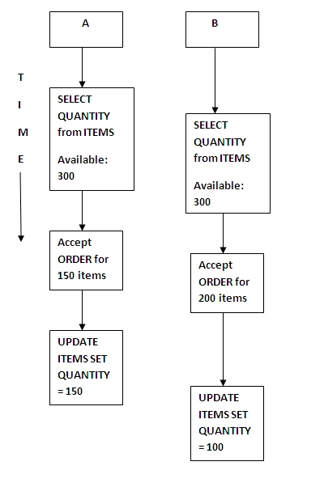

Slide 4
Uncommitted data, dirty read problem in transaction processing in SQL
Uncommitted data or dirty read problem: In a dirty read problem, A is processing an order for a client for 150 items. He checks from the ITEMS table that there are 300 available items. So he starts placing the order. A confirms the order for 150 items and updates the ITEMS table and sets the quantity to 150. Now, B receives an order for 200 items. He checks the ITEMS table to find that there is not enough inventories (150 available) and rejects the order. By using business rules and transactions a note is sent informing that more items are required. Now, due to some reason client asks A to cancel the order, so A cancels the order, rolls back and updates the ITEMS table back to 300 items. This problem is known as dirty read because B saw the uncommitted update of A.

Slide 5
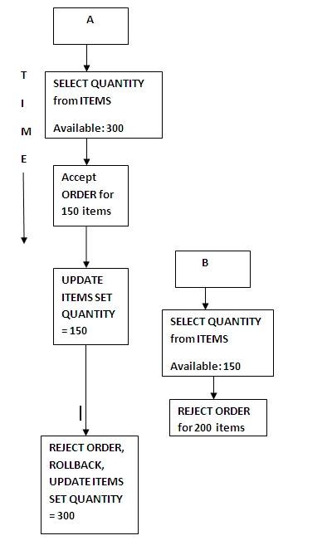

Slide 6
Deadlock
Suppose we are executing a set of transactions in the database. Let us assume the transaction as updating the address of an employee ‘James’ with ‘Tom’ address and a second transaction is updating the address of Tom to the address of James. Assume these are the concurrent transactions. What happens in this case? Here the first transaction is trying to update the address by selecting the address of Tom, while the second transaction is trying to select the address of James to update its address. When the first transaction begins it lock the address field of James for update. As soon as it locked the address of James, second transaction begins and it locks address of Tom for update. At this time, first transaction fetches the address of Tom. Since it is already locked for update, his address cannot be read by the first transaction, and it waits for update lock to release. Meanwhile the second transaction fetches the address of James, which is update locked by first transaction and it waits for its release.
Here both the transactions are waiting for each other, and it will not release the lock until it is complete. Hence waiting for the other to release the lock will never end and this state of transaction is called deadlock.

Slide 7
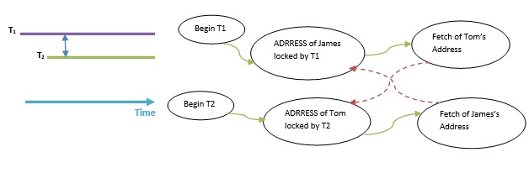
Above diagram shows how two transactions are waiting for each other and never completes.
If a deadlock occurs in the database, then the transactions have to be restarted or rolled back. In above case, if the second transaction starts after T1 fetches Tom’s address, then there would not have been a deadlock situation. It has occurred because both the transactions have started simultaneously.

Slide 8
Deadlock avoidance
It is always better to avoid deadlock in a system rather than aborting or restarting the transaction. This is waste of time and resource. Wait-for-graph is one of the methods for detecting the deadlock situation.
Wait-For-Graph
In this method a graph is drawn based on the transaction and their lock on the resource. If the graph created has a closed loop, then there is a deadlock. DBMS maintains this graph for all the transactions waiting for the resources and checks if there is a loop.

Slide 9
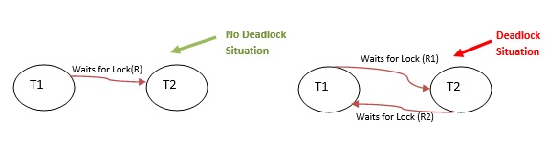
Suppose T1 and T2 are two transactions. Suppose T1 is requesting/waiting for a resource R which is held by T2. In this case, wait for graph draws an arrow from T1 to T2. If T2 releases the resource R, then this arrow is deleted.

Slide 10
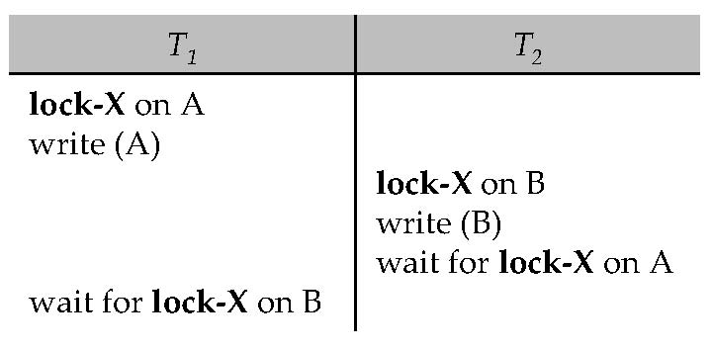
Deadlocks
Consider the following two transactions:
T₁: write (X) T₂: write(Y)
write(Y) write(X)
Schedule with deadlock

Slide 11
Deadlock Detection
Deadlocks can be described as a wait-for graph, which consists of a pair G = (V,E),
  V is a set of vertices (all the transactions in the system)
  E is a set of edges; each element is an ordered pair T_{i} T_{j}.
If T_{i}  T_{j} is in E, then there is a directed edge from T_{i} to T_{j}, implying that T_{i} is waiting for T_{j} to release a data item.
When T_{i} requests a data item currently being held by T_{j}, then the edge T_{i}  T_{j} is inserted in the wait-for graph. This edge is removed only when T_{j} is no longer holding a data item needed by T_{i}.
The system is in a deadlock state if and only if the wait-for graph has a cycle. Must invoke a deadlock-detection algorithm periodically to look for cycles.

Slide 12
Deadlock Detection (Cont.)
Wait-for graph without a cycle
Wait-for graph with a cycle

Slide 13
Deadlock Recovery
When deadlock is detected :
  Some transaction will have to rolled back (made a victim) to break deadlock. Select that transaction as victim that will incur minimum cost.
  Rollback -- determine how far to roll back transaction
    Total rollback: Abort the transaction and then restart it.
    More effective to roll back transaction only as far as necessary to break deadlock.
  Starvation happens if same transaction is always chosen as victim. Include the number of rollbacks in the cost factor to avoid starvation

Slide 14
Multiple Granularity
The granularity of locks in a database refers to how much of the data is locked at one time. In theory, a database server can lock as much as the entire database or as little as one column of data.
Multiple Granularity allow data items to be of various sizes and define a hierarchy of data granularities, where the small granularities are nested within larger ones
Can be represented graphically as a tree.
When a transaction locks a node in the tree explicitly, it implicitly locks all the node's descendents in the same mode.
Granularity of locking (level in tree where locking is done):
  fine granularity (lower in tree): high concurrency, high locking overhead
  coarse granularity (higher in tree): low locking overhead, low concurrency

Slide 15
Example of Granularity Hierarchy
The levels, starting from the coarsest (top) level are
  database
  area
  file
  record

Slide 16
END

